Slide 1

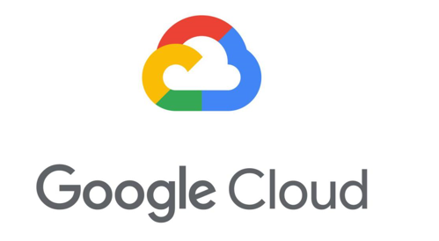
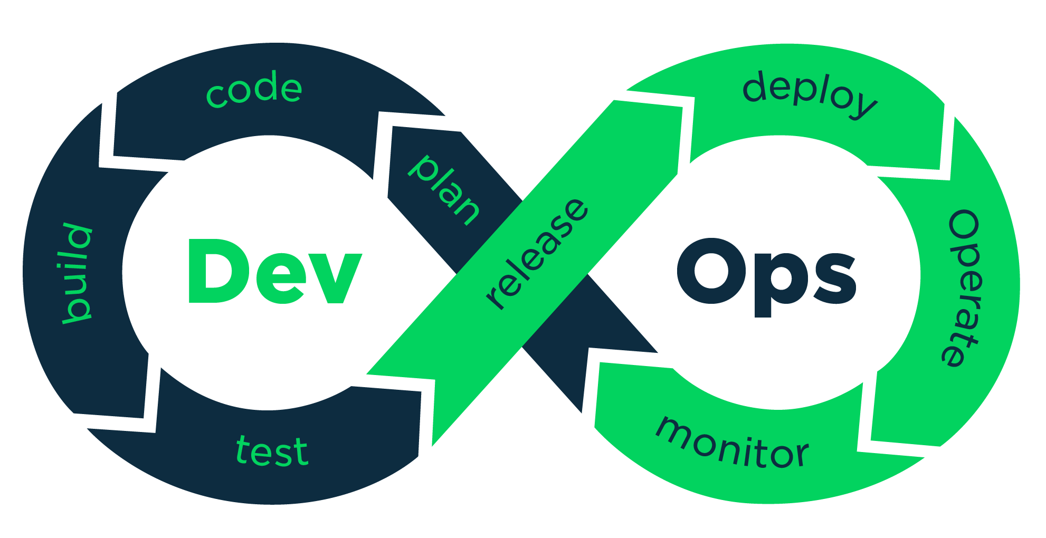
Ishaq Mohammed

Slide 2
Agenda
About Me
Course Content
Job opportunities
Our success stories
Traditional infrastructure
Problems with traditional IT approach
Demo Real time scenario
Q & A

Slide 3
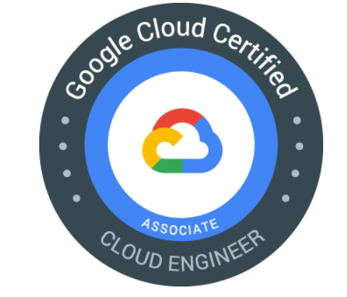
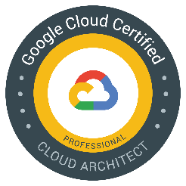


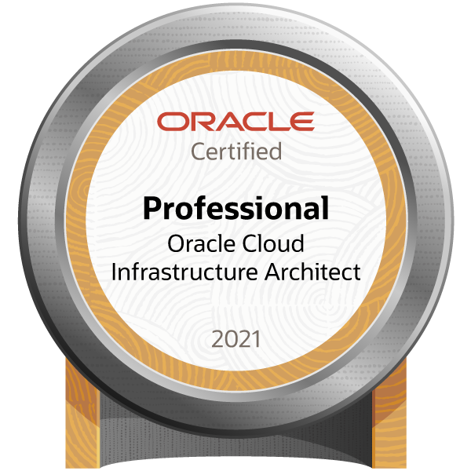
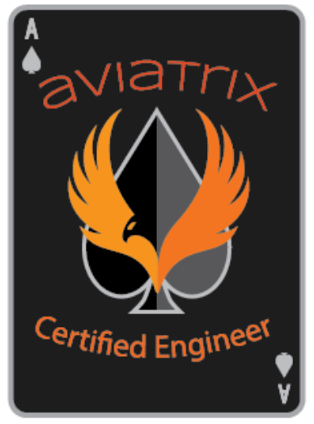
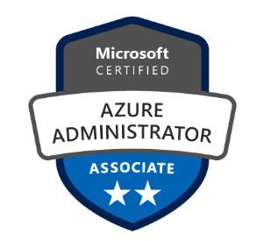
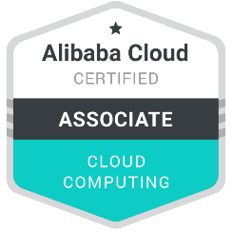

About Me
Cloud Consultant by profession
Ishaq have around 17+ years of Teaching and work experience into Cloud, DevOps, Hyper Converged Network, Infrastructure services like storage, Backup & VMware technologies.
Along with some industry recognized certifications I hold Master of Technology from JNT University, Hyderabad.
3

Slide 4
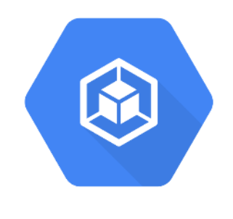

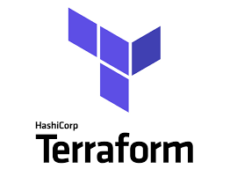
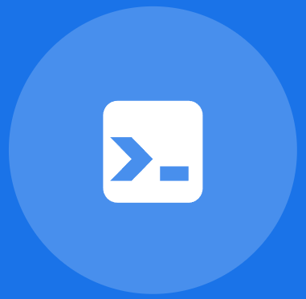
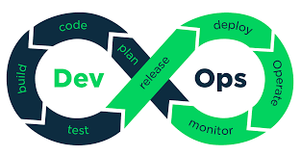
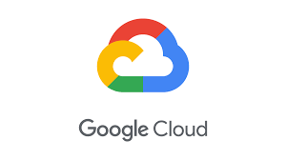
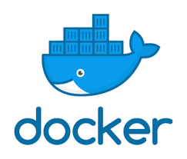
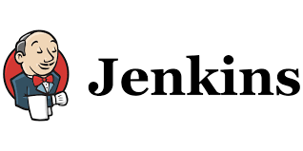

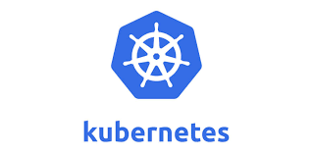


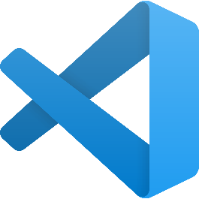
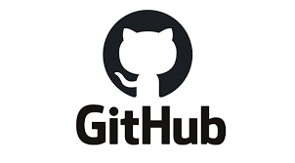
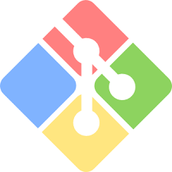
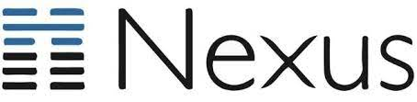
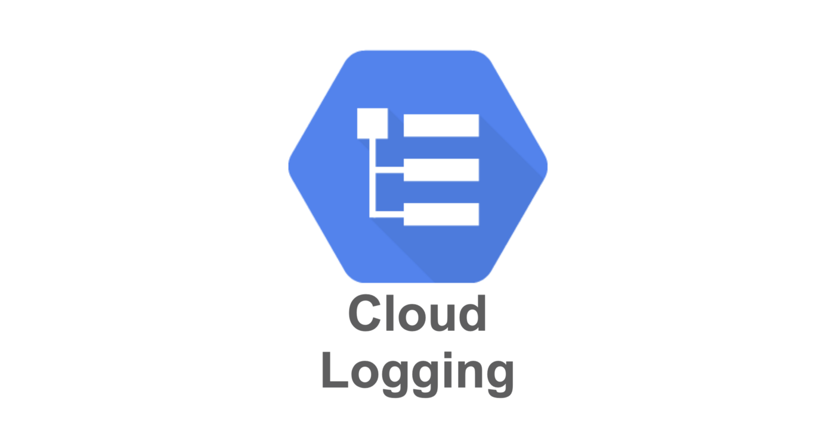
Course Content

Slide 5
Benefits of this course
Real-Time examples
Interview question
Certification guidance
Mock Interviews
Daily recordings
E-books
Sample CV’s
100% Career Assistance

Slide 6
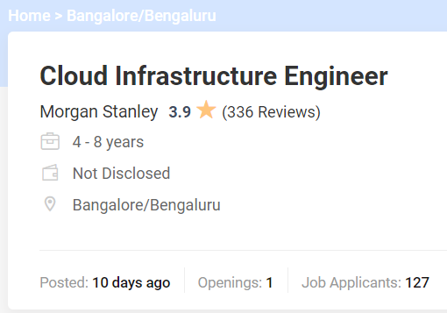
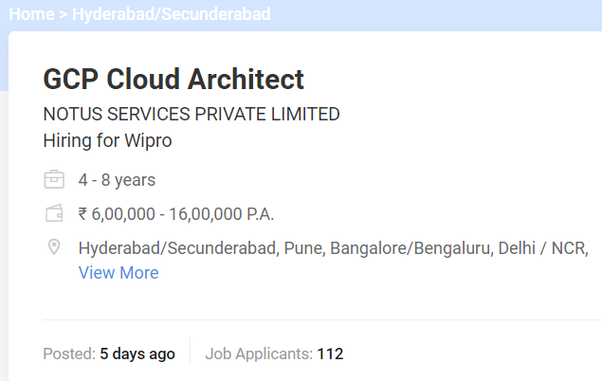
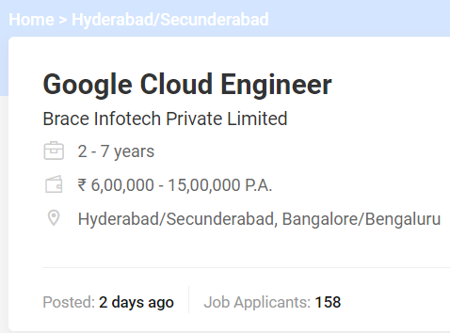
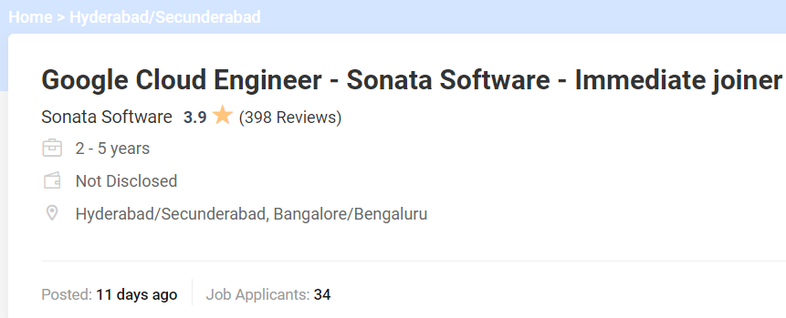
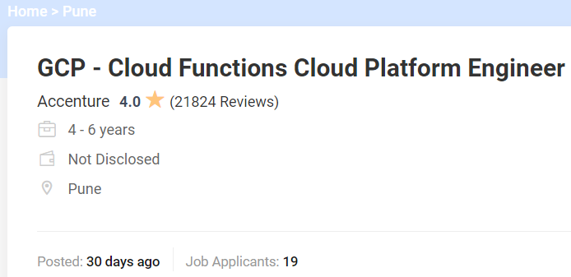
Job opportunities..

Slide 7
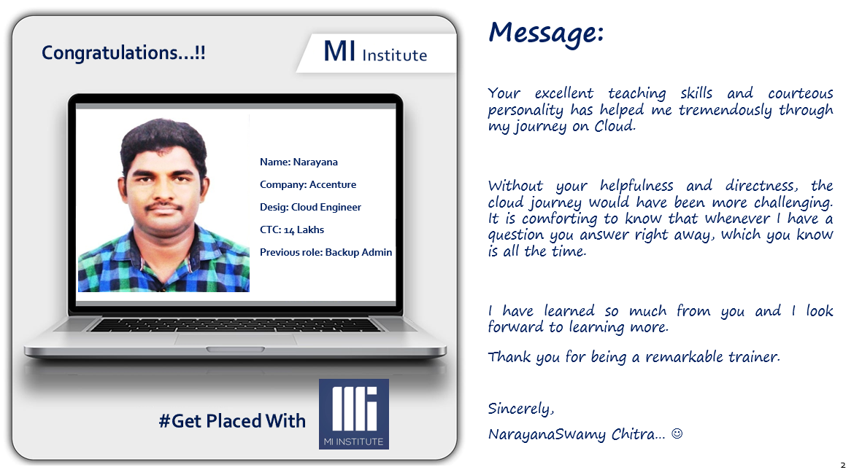
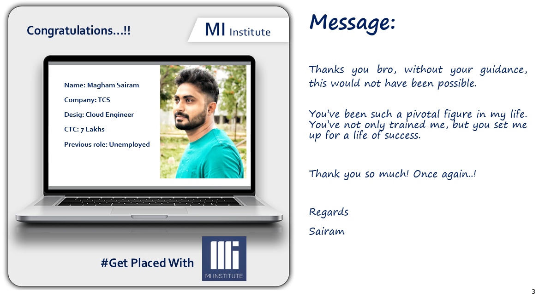
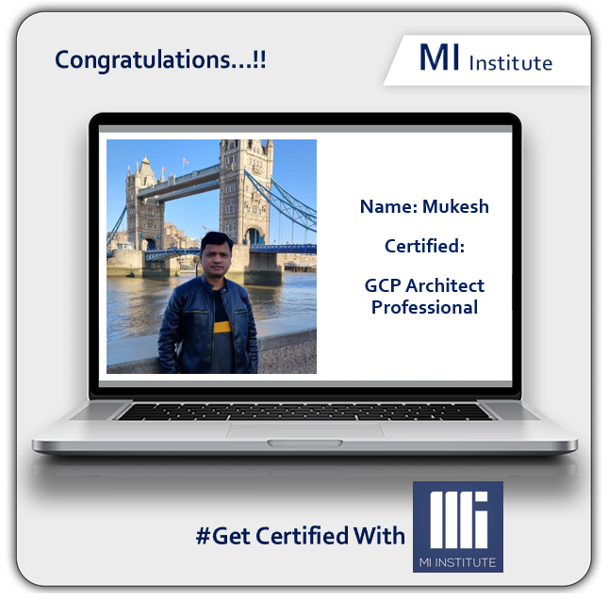
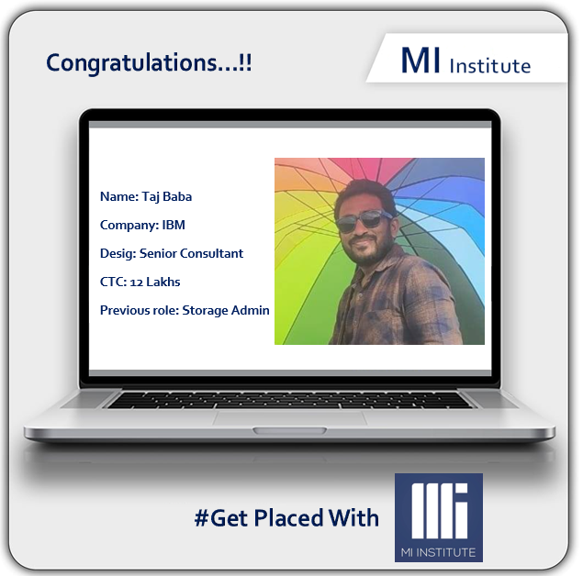
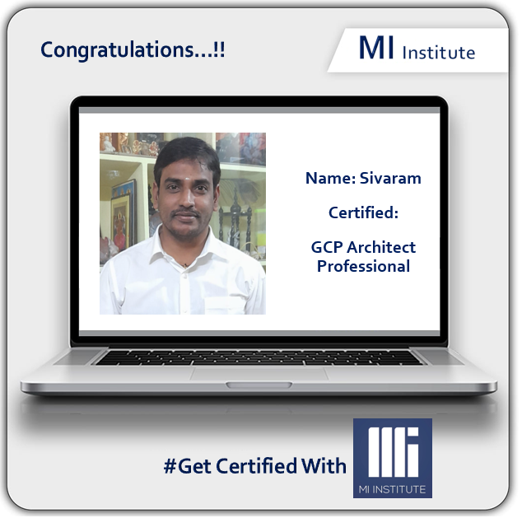
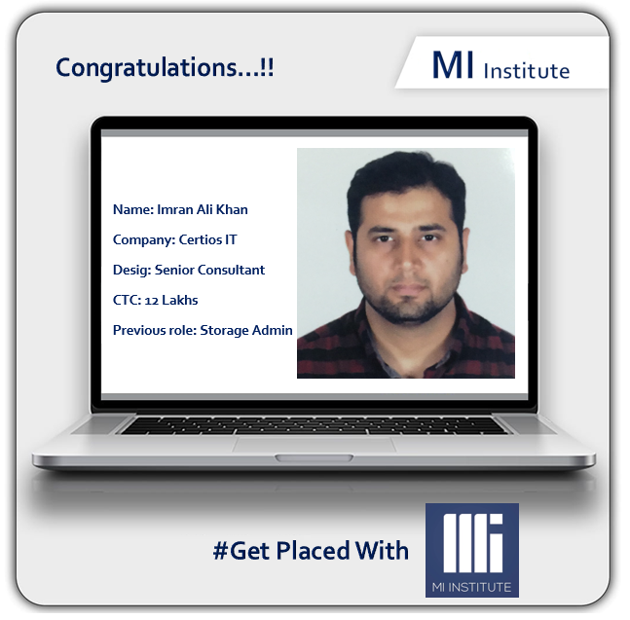
Our Success Stories…

Slide 8
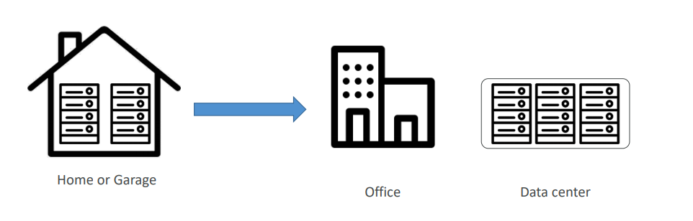
Traditionally, how to build infrastructure

Slide 9
Problems with traditional IT approach
Pay for the rent for the data center
Pay for power supply, cooling, maintenance
Adding and replacing hardware takes time
Scaling is limited
Hire 24/7 team to monitor the infrastructure
How to deal with disasters? (earthquake, power shutdown, fire…)

Slide 10
What is Cloud Computing?
Cloud computing is the on-demand delivery of compute power, database storage, applications, and other IT resources
Through a cloud services platform with pay-as-you-go pricing
You can provision exactly the right type and size of computing resources you need
Simple way to access servers, storage, databases and a set of application services

Slide 11

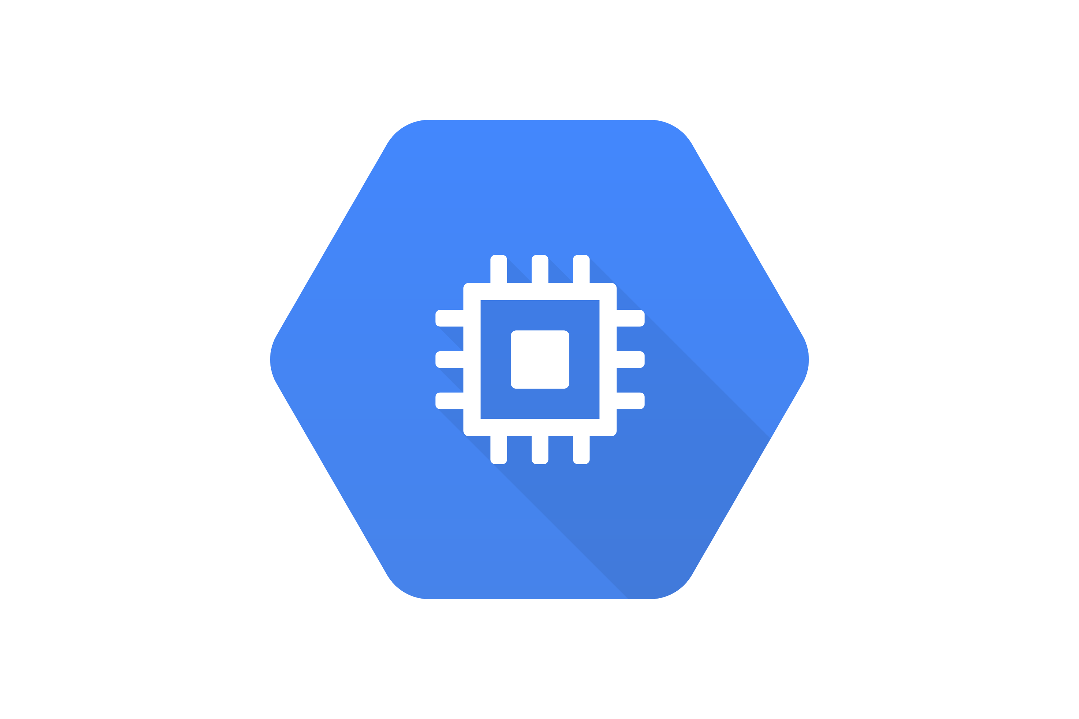


Architecture: Web Application> Static website - Manual
Development Team
DEV App
health check
Deploy App on DEV ENV
Users
Deploy App on UAT ENV
UAT App
health check
PROD App
health check
Deploy App on PROD ENV

Slide 12
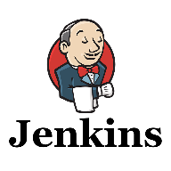
Architecture: Web Application> Static website – Jenkins Automation
Development Team
DEV App
health check
Deploy App on DEV ENV
Users
Deploy App on UAT ENV
UAT App
health check
PROD App
health check
Deploy App on PROD ENV

Slide 13
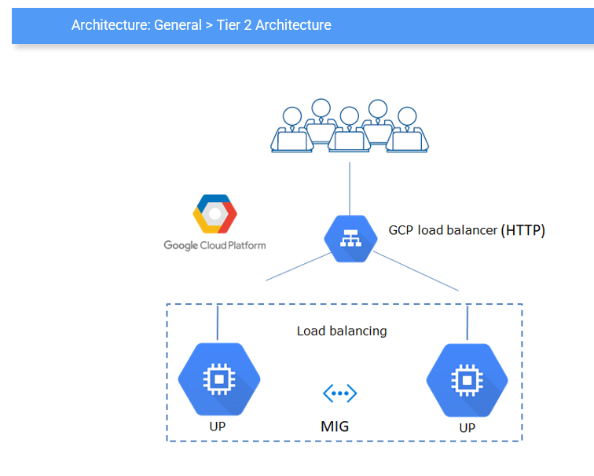
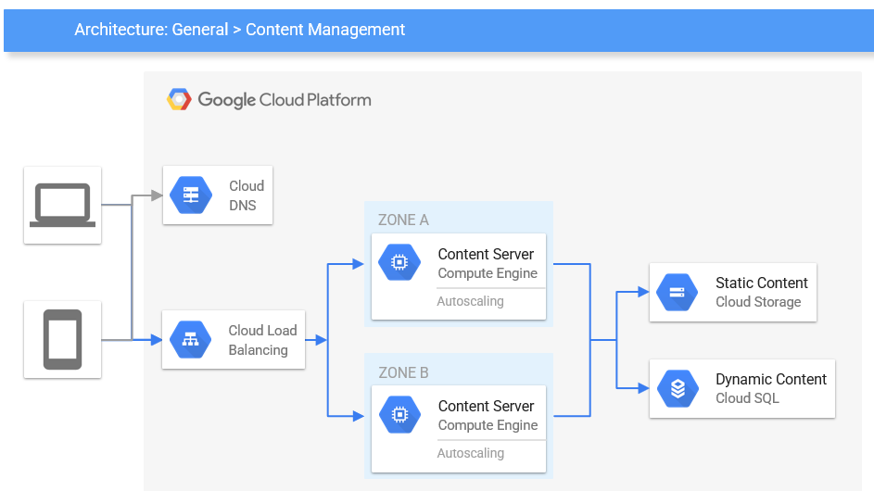
Sample patterns…

Slide 14

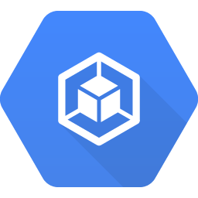
Architecture: Web Application Spring App – Jenkins Automation
Docker Images Container Registry
Development Team
K8s Load Balancer
Kubernetes Cluster POD
Pet Clinic
Kubernetes Cluster Container Engine
Users

Slide 15

Round out your skills with training
Google Cloud Platform Online Training with DevOps
Batch starts: 20th March 2023 @ 7 am IST
Course duration - 45 days
To block your seat call
Call Us: +91 8008008662
Visit us: https://miinstitute.in
3 sessions
Free
15

Slide 16
Thank you

